Slide 1
Green Propellant Thrust Stand
Team 517
Jeffrey Hill, Aidan Hoolihan, Ryan Kaczmarczyk,
Nicholas Jensen, Edward Zapert
10/8/2024

Slide 2
Team Sponsors & Advisors
Marshall Space Flight Center
Sponsors:
Advisors:
Ebony Bland
Aerospace Engineer
Nicole Vaughn
Liquid Propulsion Engineer
Alexandre Berger, Ph.D.
Assistant Professor
Shayne McConomy, Ph.D.
Professor

Slide 3
Team Introductions
Jeffrey Hill
Thermal Fluids Engineer
Nicholas Jensen
Manufacturing Engineer
Edward Zapert
Design Engineer
Aidan Hoolihan
Materials Engineer
Ryan Kaczmarczyk
Controls Engineer

Slide 4
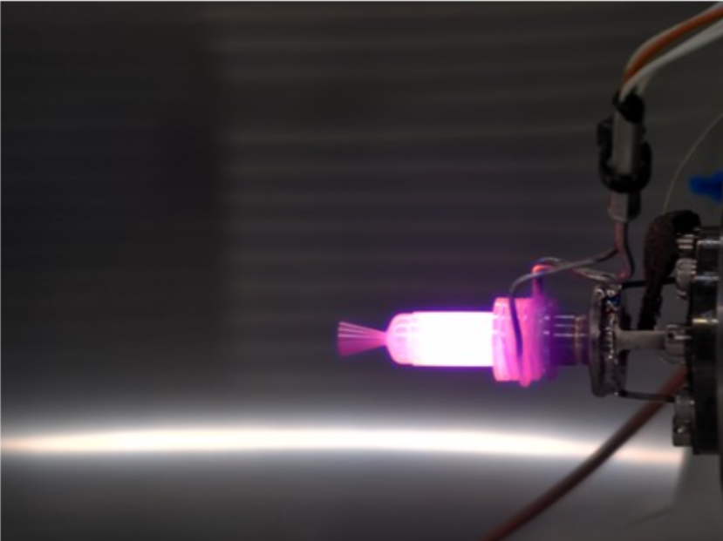
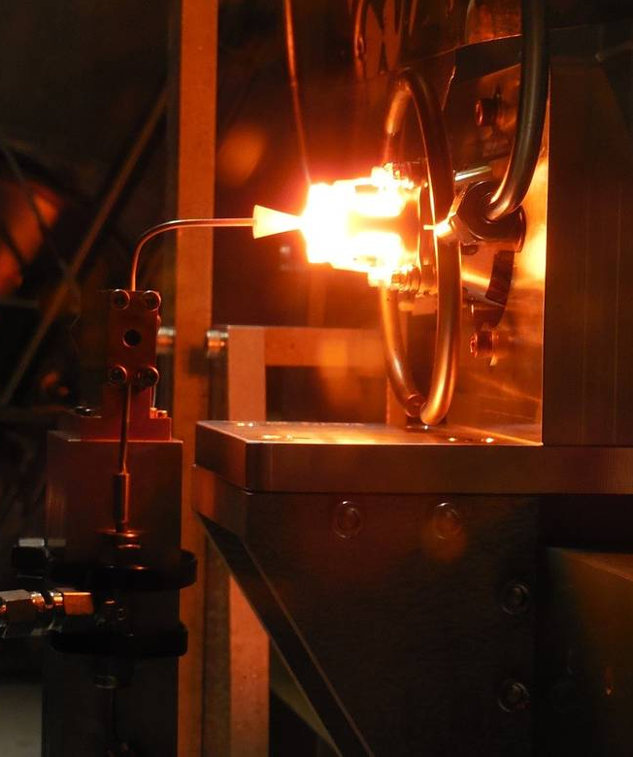
Objective
The objective of this project is to develop an improved thrust stand for NASA-MSFC that can take accurate measurements of a 0.1N green propellant thruster

Slide 5
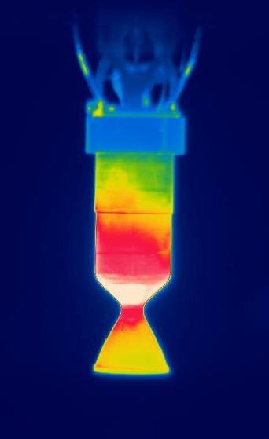
Project Brief
Jeffrey Hill
Green Propellant Thrust Stand
Accurately Measure 0.1N of Thrust
Create Thorough Documentation
Minimize Uncertainty

Slide 6
Project Background
Jeffrey Hill
Green Propellant
Safer to store and use than Hydrazine
Less expensive than Hydrazine
Requires less fuel onboard
ASCENT
(AF-M315E)
Developed by the Air Force Research Lab
Green propellant primarily used by MSFC

Slide 7
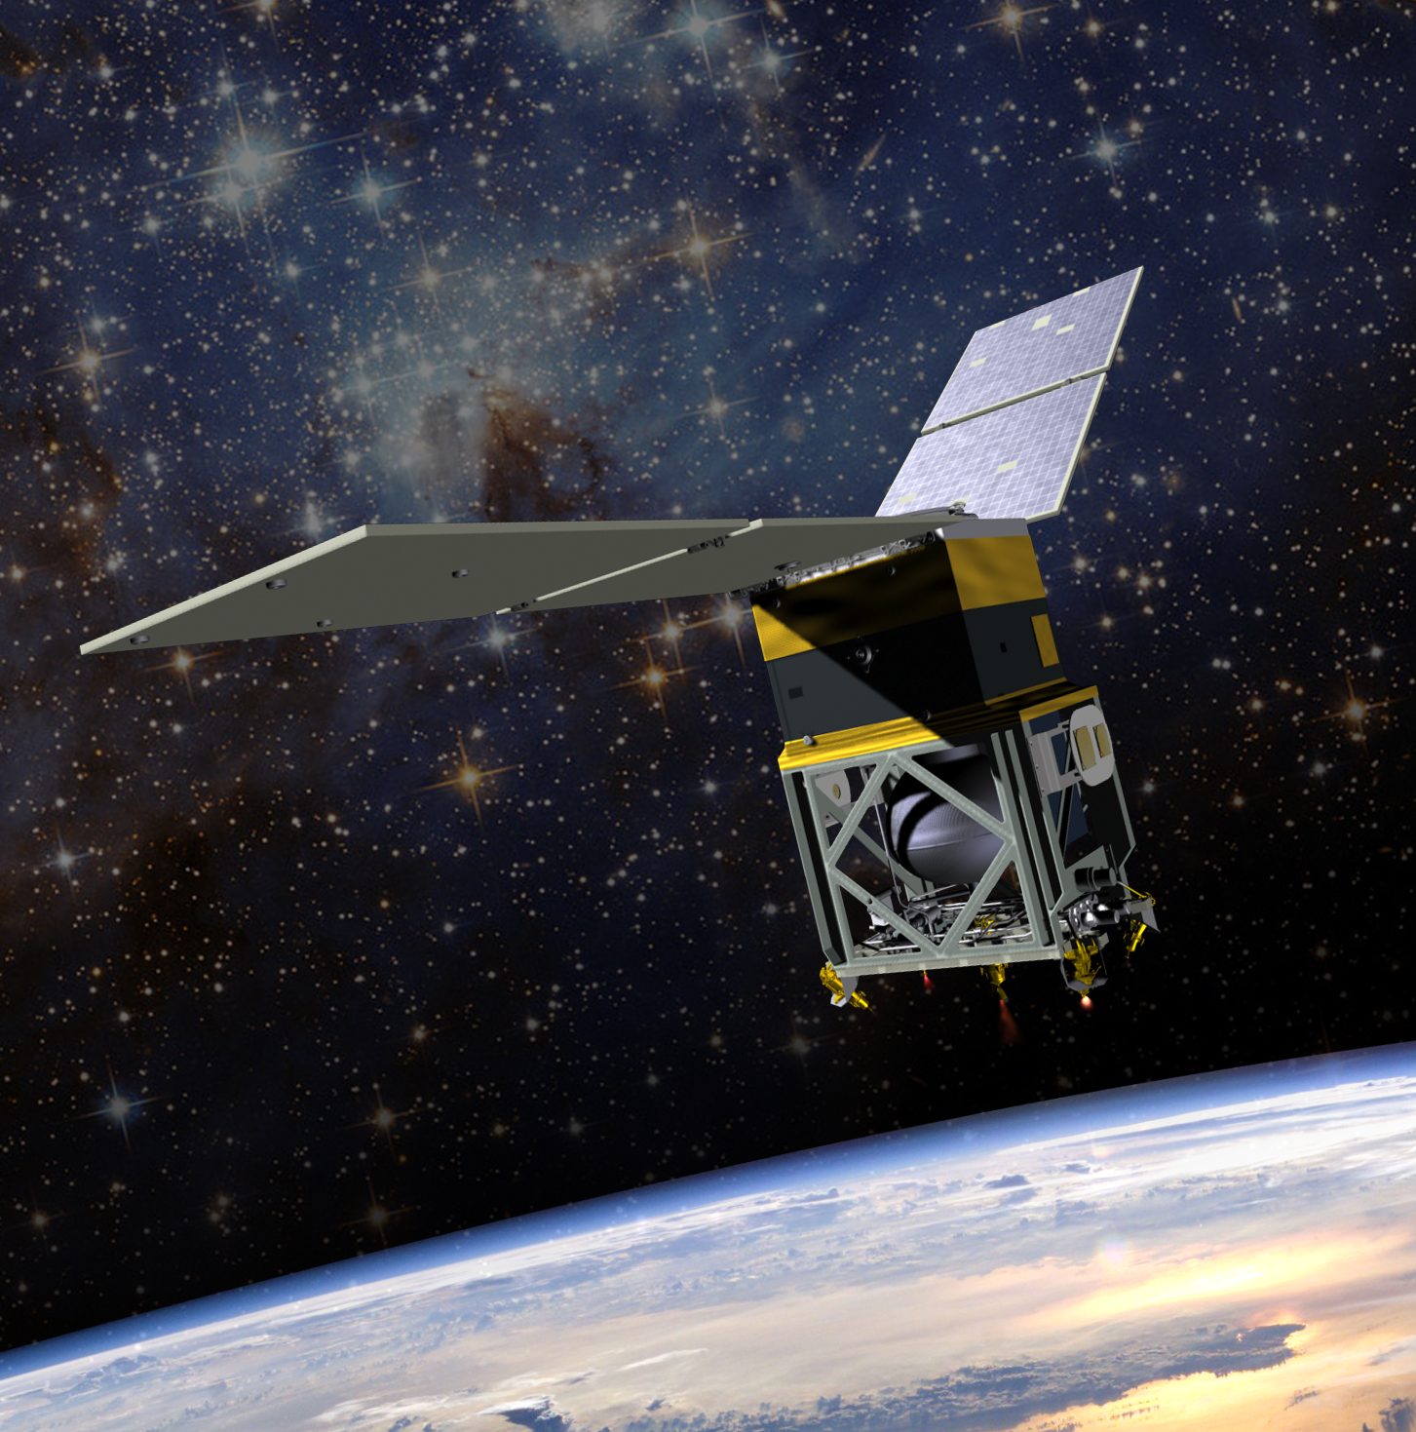
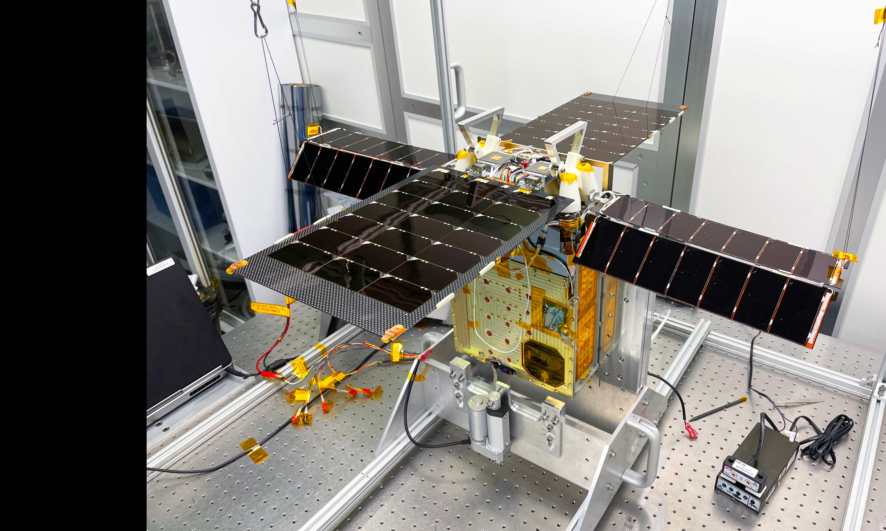
Project Background
Jeffrey Hill
GPIM
Tech demonstration mission
Altitude control, orbital inclination, orbital lowering
Lunar Flashlight
First planetary CubeSat mission with "green" propulsion
Map ice in permanently shadowed regions near the Moon's south pole.

Slide 8
Key Goals
Note: this diagram is for visual purposes only and is not demonstrative of design choice
Jeffrey Hill
Torque from Fluid Lines
Green
Propellant
Thrust Sensor
Thruster Angle
Minimize
Sensor Error
External Vibrations

Slide 9
Key Goals
Jeffrey Hill
Easily Manufacturable
Manufacturable by Universities

Slide 10
Key Goals
Jeffrey Hill
Adapts to hold a 5N Thruster

Slide 11
Key Goals
Jeffrey Hill
Easily Washable

Slide 12
Key Goals
Jeffrey Hill
Easily Washable

Slide 13
Key Goals
Jeffrey Hill
Vacuum Chamber
Instrumentation is Visible

Slide 14
Key Goals
Jeffrey Hill
Vacuum Chamber
Thrust: 0 ± 0.1 mN
Sensors can be remotely calibrated
Instrumentation is Visible

Slide 15
Assumptions
Jeffrey Hill
Thruster Uses Green Propellant
ASCENT
Volumetric Constraint
1.5 ${ft}^{3}$
12”
18”
12”

Slide 16
Assumptions
Jeffrey Hill
Thruster Uses Green Propellant
Ignition Occurs Remotely
ASCENT
Test In Progress

Slide 17
Assumptions
Jeffrey Hill
Thruster Uses Green Propellant
Ignition Occurs Remotely
ASCENT
Test In Progress
Thermocouple sustains up to 1600°C

Slide 18
Assumptions
Jeffrey Hill
Components Withstand Vacuum-like Conditions
(10⁻⁷ Torr < p < 10⁻⁴ Torr)

Slide 19
Markets
Jeffrey Hill
NASA Marshall Space Flight Center
Primary Market
Universities
US Military
Secondary Markets
Private Space Companies

Slide 20
Stakeholders
Jeffrey Hill
NASA-MSFC
Ebony Bland
Nicole Vaughn
Christopher Burnside
FAMU-FSU College of Engineering
Dr. McConomy
Dr. Berger
Elias Hasse
Tripp Lappalainen
Jacob Schmitt

Slide 21
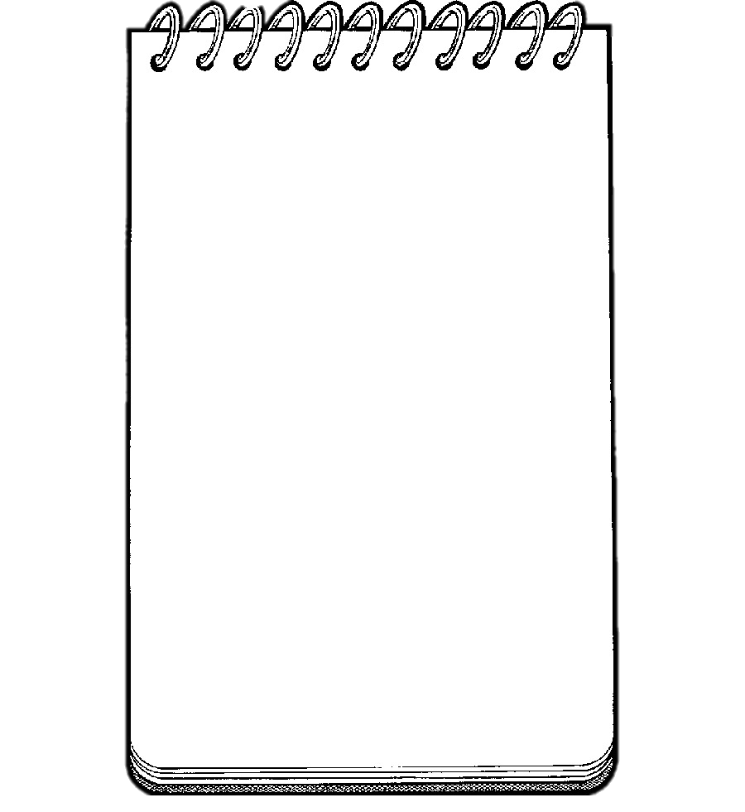
Customer Needs
Ryan Kaczmarczyk
Testing occurs in a vacuum chamber, and it is mounted in this chamber and measured using a thrust sensor to gauge force.
Right now, the thrust stand is too heavy, isn’t as accurate as we would like, and is hard to clean.
Yes, the vacuum chamber is a constraint, with a volume of 12”L x 18”W x 12”H inside.
While the vacuum is on, the pressure reaches 1e-6 Torr.
The thruster can reach temps up to 1600C.
Interpreted Needs:
- Thrust stand needs to withstand vacuum conditions
What improvement can be made over current designs?
While the vacuum is on what pressure does it reach?
How hot does the thruster get?
What is the typical testing setup of the thrust chamber?
Are there any size constraints?
- Thrust stand should be able to be carried by one person
- The thrust stand needs to be easy to clean
- Provide accurate measurements
- Thrust stand can be no bigger than 12” x 18” x 12”
- The stand/sensor needs to endure temps up to 1600C
- The stand/sensor needs to endure a pressure of 1e-6 Torr

Slide 22
Functional Decomposition
Ryan Kaczmarczyk
Thrust Stand
Controls
Life Cycle
Structure
Calibration
Measurement
Computation
Calibrates Remotely
Calibrates Under Vacuum
Measures Thrust
Measures Temperature
Measures Pressure
Calculates/ Reduces Error
Stores Data
Upkeep
Cleans Easily
Manufacturing
Made w/ Access. Materials
Reproducible
Connectivity
Accessibility
Adaptability
Interfaces w/ Terminal Block
Maneuvered Easily
Has Access to Internal Connections
Visible via View Ports
Scalable

Slide 23
Functional Decomposition
Ryan Kaczmarczyk
Controls
Calibration
Measurement
Computation
Calibrates Remotely
Calibrates Under Vacuum
Measures Thrust
Measures Temperature
Measures Pressure
Calculates/ Reduces Error
Stores Data

Slide 24
Functional Decomposition
Ryan Kaczmarczyk
Life Cycle
Upkeep
Cleans Easily
Manufacturing
Made w/ Access. Materials
Reproducible

Slide 25
Functional Decomposition
Ryan Kaczmarczyk
Structure
Connectivity
Interfaces w/ Terminal Block
Accessibility
Maneuvered
Easily
Has Access to Internal Connections
Visible via View Ports
Adaptability
Scalable

Slide 26
Future Work
Jeffrey Hill
Advisor Meeting
Research Sponsor Articles
NASA-MSFC Visit

Slide 27
Quick Recap
Jeffrey Hill
Thrust
Temperature
Pressure
Accurate
Manufacturable
Remote Calibration
Scalable
Cleanable
Visibility
Green Propellant Thrust Stand
Vacuum Conditions
Remote Calibration
ASCENT
NASA MSFC
FAMU-FSU COE

Slide 28
References
https://www.rubicon.space/product/1/0-1n-ht-thruster
https://www.nasa.gov/missions/tech-demonstration/nasas-green-propellant-infusion-mission-nears-completion/
https://www.nasa.gov/missions/tech-demonstration/new-green-propellants-complete-milestones/
https://www.jpl.nasa.gov/missions/lunar-flashlight/
https://www.nasa.gov/missions/tech-demonstration/green-propellant-infusion-mission-gpim-overview/

Slide 29
Key Goals
Accurate
Manufacturable
Remote Calibration
Scalable
Cleanable
Visibility
Notes:
Accurately measure 0.1N of thrust
Manufacturability by a university
Perform a remote, in-place calibration in a vacuum environment

Slide 30
Back Up Slides

Slide 31
Slide Headline
Try to keep text at 16 pt minimum.
Try to put as few words as possible on the slide if you’re using for a presentation.
Mix and match the backgrounds as shown in this template or just use one throughout.
You can put department/unit logos in slide master at Horizontal 0.89” Vertical 6.44” From top left corner

Slide 32
Font Check
This is 10-point
This is 15–point Times
This is 20–point
This is 25–point
This is 30–point
This is 35–point
This is 40–point
This is 50–point
This is 60–point
This is 72–point
Notes:
Use at least 20-point font in Room A105, B134, and B136
Use at least 25-point font in Room B135

Slide 33
Assumptions
Vacuum Pressure (10⁻⁷ Torr < p < 10⁻⁴ Torr)
Green Propellant (ASCENT)
12in L X 18in W X 12in H Volume
Remote Initiation
Thruster Temperature (Up to 1600°C)
Notes:
Operate under a vacuum
Green propellant used
Thrust sensor force endurance forces similar to thrust
Labview?
Visible from view ports
Spatial constraint
Remote ability
Maybe add about temp up to 1600 C

Slide 34
College of Engineering Color Palette
1 2 3 4
Pantone: PMS 195 C
RGB: 120, 47, 64
Hex: #782F40
CMYK:19, 90, 50, 55
1 2 3 4
Pantone: Black C
RGB: 0, 0, 0
Hex: #000000
CMYK:0, 0, 0, 100
Garnet
Black
1 2 3 4
RGB: 238, 118, 36
Hex: #EE7624
CMYK:2, 66, 99, 0
1 2 3 4
Pantone: PMS 000C
RGB: 255, 255, 255
Hex: #FFFFFF
CMYK: 0, 0, 0, 0
Fang
Orange
White
Notes:
Avoid 75% Black in B135

Slide 35
Accent Color Palette
1 2 3 4
RGB: 0, 59, 111
Hex: #003B6F
CMYK:
1 2 3 4
RGB: 0, 59, 111
Hex: #003B6F
CMYK:
1 2 3 4
RGB: 251, 236, 93
Hex: #FBEC5D
CMYK:
1 2 3 4
RGB: 219, 215, 210
Hex: #DBD7D2
CMYK:
1 2 3 4
RGB: 251, 236, 93
Hex: #FBEC5D
CMYK:
1 2 3 4
RGB: 219, 215, 210
Hex: #DBD7D2
CMYK:
Tardis Blue
Tardis Blue
Corn
Timberwolf
Corn
Timberwolf
1 2 3 4
RGB: 206, 0, 88
Hex: #CE0058
CMYK: 0, 100, 43, 12
1 2 3 4
RGB: 206, 0, 88
Hex: #CE0058
CMYK: 0, 100, 43, 12
1 2 3 4
RGB: 104, 40, 96
Hex: #682860
CMYK:
1 2 3 4
RGB: 220, 220, 220
Hex: #DCDCDC
CMYK:
Rubine Red
Rubine Red
Imperial
Gainsboro
1 2 3 4
RGB: 72, 146, 155
Hex: #48929b
CMYK:
1 2 3 4
RGB: 64, 224, 208
Hex: #40E0D0
CMYK:
1 2 3 4
RGB: 255, 139, 0
Hex: #FF8B00
CMYK:
Asagi-iro
Turquoise
American Orange
Notes:
Remove American orange add hyperlink grey
Make corn the last for b135
All work in 134 imperial move later
Tardis doesn’t work in b136

Slide 36
F7AB19
D67F15
EE7624
D64615
F73119
Analogous
6E3610
F0A16C
EE7624
6E4931
BASB1C
Monochromatic
A14508
4BED3B
EE7624
250CED
2010A1
Triad
A1470C
FF8C40
EE7624
0098A1
24E2ED
Complementary
28A164
2FED8D
EE7624
0848A1
1871ED
Split Complementary
EDAC2F
3BED93
EE7624
0C6AED
ED2F18
Double Split Complementary
ED660C
C7ED3B
EE7624
0CE1ED
A418ED
Square
BA7E09
87724A
EE7624
60EFCF
09BA61
Compound
https://color.adobe.com/create/color-wheel
AD551A
6E3610
EE7624
FA7625
D46820
Shades
Notes:
These are the variants that work well with Fang Orange. The bolded items show well on the projectors.

Slide 37
85412D
8F3831
782f40
8F3176
792D85
Analogous
C44D69
8E626D
782F40
C48796
451B25
Monochromatic
C43959
78743B
782F40
236178
43A2C4
Triad
C43959
C46078
782F40
25C43D
2F783A
Complementary
93C460
577835
782F40
39C49D
297861
Split Complementary
784435
5A783B
782F40
237860
6E2978
Double Split Complementary
782337
78683b
782F40
237830
293978
Square
AB4D32
DEBAAF
782F40
5D8555
70AB32
Compound
https://color.adobe.com/create/color-wheel
38161E
C44D69
782F40
853447
5E2532
Shades

Slide 38
A105
A105
B135 Stage Left
B135 Stage Right
B136
B134, A105
B135

Slide 39
Border Line
Border Line
Border Line
Center of White Space
Center of Slide
Middle of Slide
Middle of White Space
Edge of Branding
Border Line
Notes:
Vertical lines from top down.
Borderline and top of title. (0.5 inch)
Center of Slide (0 inch y-direction for the entire slide)
Center of Design Content (0 inch y-direction considering the title, footer, and negative space)
Bottom of Design Content (0.25 in gap to the footer. 0.75 to the bottom of the screen)
Horizontal lines from left to right
Borderline (0.5 inch)
Center of design content.
Center of slide (0 inch y-direction for the entire slide)
Borderline (0.125 inch all around)

Slide 40
Markets
Jeffrey Hill
Primary Market
NASA-MSFC
Secondary Markets
Universities
CubeSAT Developers
US Military
Private Space Companies

Slide 46
Customer Needs
MEASUREMENT | STORAGE | INTERFACING
The plume temperature sensor accurately measures up to 1600 °C | Fits in a 12”L x 18”W x 12”H volume | Interfaces with an Arduino microcontroller and is compatible with LabVIEW
Able to record thrust exerted and pressure in relevant locations | Can withstand a maximum of 1e-6 vacuum pressure without outgassing | All sensors and wiring will terminate at the terminal block for ease of connection and portability
 | Designed to hold a 0.1N thruster and potentially scalable up to a 5N class thruster | Made of materials and parts that can be created with resources and shops that other universities will have access to

